Slide 1
LOAN STATUS PREDICTION
TEAM - G7
MENTOR - MR.PARTH
TEAM MEMBERS - Kafeel
Nitish
Jagan
Srinivas mamidala
Madhubalini
Dated - 04/03/2021

Slide 2
Business Problem
To predict the impact of the incident raised by the customer.
Objective
The objective of the ML project is to create a model that will classify how much loan a customer can obtain based on the various factors.

Slide 3
Project Architecture:
BASIC DATA EXPLORATION
DATA PREPROCESSING
VISUAL EDA
FEATURE SELECTION
OUTLIER/MISSING VALUE TREATMENT
MODEL SELECTION
DEPLOYMENT

Slide 4
DATA EXPLORATION
Data size - { Traindata (614,13) , Test data (367,12) }
Data type- Loan_ID: Qualitative.
Gender: Categorical.
Married: Categorical.
Dependents: Categorical.
Education: Categorical.
Self_Employed: Categorical.
Applicant Income: Quantitative.
Co-applicant Income: Quantitative.
LoanAmount: Quantitative.
Loan_Amount_Term: Categorical.
Credit_History: Categorical.
Property_Area: Categorical.
Loan_Status: Categorical.
Here we are dropping LOAN ID (since it doesnt affect the target variable)
and the target variable is LOAN STATUS

Slide 5
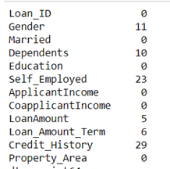
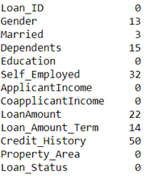
NULL VALUES IN THE DATA SETS (snaps from code notebook)
TEST DATA
TRAIN DATA

Slide 6
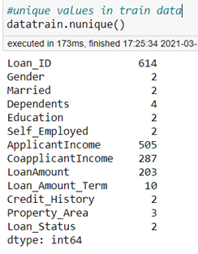
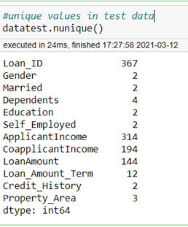
UNIQUE VALUES IN EACH COLUMNS(snaps from code notebook)

Slide 7
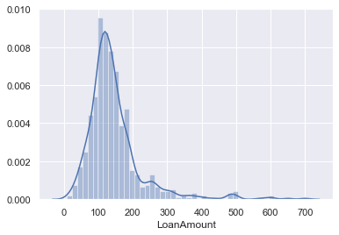
Handling null values was done replacing nulls with the corresponding “mode”.
Target variable, “loan_status” is encoded with “0” for no and “1” for yes.
Skewness check :

Slide 8
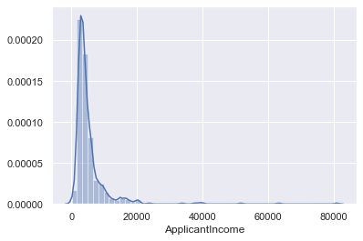
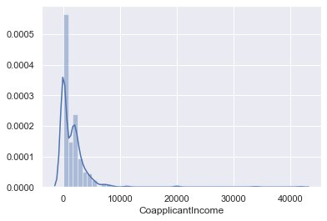

Slide 9
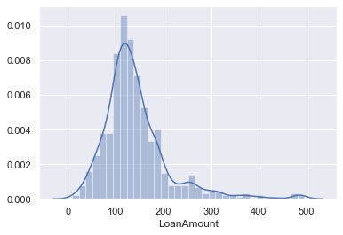
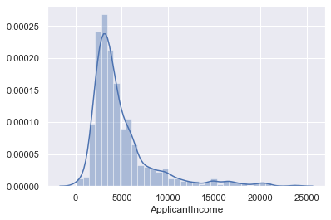
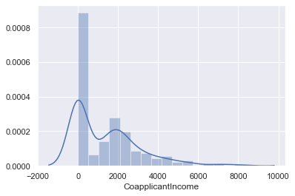
HANDLING THE OUTLIERS :
Removing all above the 0.99 percentile values in the ‘loan amount’ , ‘applicant income’ and ‘co-applicant income’

Slide 10
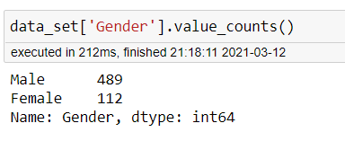
There is imbalanced data in the gender,it could lead to a discriminative model which will be treated by resampling it.
This snap from the code notebook gives us the inference that male:female ratio in the data collected is around 80:20.
IMBALANCED DATA TREATMENT:
We have to drop the “Gender”, to avoid data missing and bias model.

Slide 11
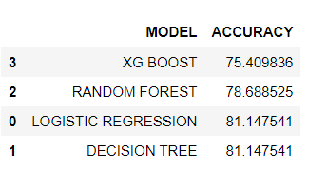
MODEL BUILDING:
We have tried few models namely LOGISTIC REGRESSION,DECISION TREE,RANDOM FOREST,XG BOOST and obtained the following accuracy:
As of now, logistic regression and d-tree gives good accuracy, we are choosing logistic model to deployment.

Slide 12
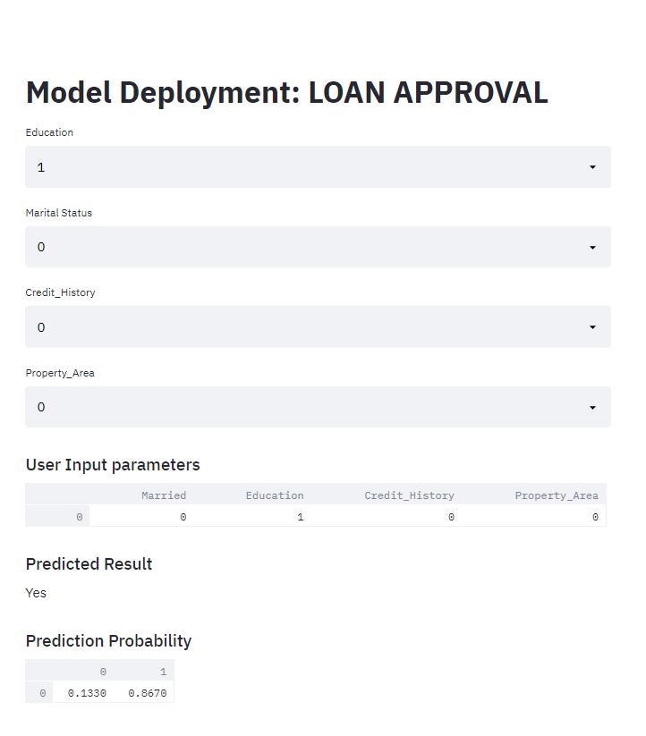
DEPLOYMENT

Slide 13
Thank you!

